Slide 1


AP-Planning Process
August 2017

Slide 2

AGENDA
Agenda Day-1
AP Walkthrough 20 mins
AP Workflow and User Roles 40 mins
Break 10 mins
AP Administration (Setup Settings) 30 mins
Assortment Strategy 2 hrs
** Batches run(beforehand and Night- 6 hrs)

Slide 3

Ground Rules
Rules for the Session !
Make the session interactive
Ensure all issues are clearly communicated and captured
If we don’t know the answer to something, we will log an action on the Action Log and move on
In interest of time, any topic requiring a detailed discussion will be discussed separately.
Please do not use phones during the session
Please close your laptops (will use only during hands on)
Be on time

Slide 4
Introduction
Why Assortment Planning?
Retailing has become significantly more complex/challenging with hundreds of stores (of different pattern) with variable customer demands
Intensified Competition in the market (Brick & Mortar, E-com)
Maximize Sales with the Right Range Assortment
- Align with the Merchandising Plan (MFP/LP)and PLM Order management.
Process Flexibility
Build Assortment in Layers
Plan the Full Lifecycle- Plan the entire lifecycle, from launch to normal selling to clearance and exit.
Plan once and execute everywhere – Integrate data with other Oracle solution like RMS, SPO, Clearance/Optimization etc.

Slide 5
What are the benefits
Increase in Gross Margin Dollars by 1 - 7%*
Reduce inventory by 1.5 - 3%*
Plan assortments and sales to meet customer demand, based on optimized history, in align with budget.
Assortments based on Price point strategy, UDA strategy.
Fresher merchandise in the stores, creating new options per product lifecycle type
Accelerates planning process

Slide 6
What it does
Go-to-market with Shopping List
Calculate each cluster’s assortment size
Recommends wedge assortments
Create place holders with quantities per store
Focuses on customer segmented demand (use store attributes)
Use attributes to build and appraise the assortment (please holders created consider store attributes)
Embedded optimization
Standardized business processes
Recommends the minimum number of style-colors based on the assortment strategy and buy quantity that best fit the attribute goals planned for each cluster.
Calculates expected sales units based on the lifecycle of the item and its planned rate of sale by cluster.

Slide 7

AP
So, How AP Works?

Slide 8

AP
Little bit more detail ….

Slide 9
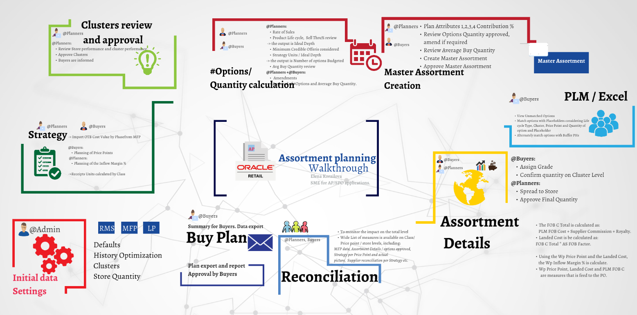
3)
4)
2)
1)
5.1)
5.2)

Slide 11
AP – User Role
Steps | Admin | Planning | Buying | Activities | Out-Put
Setup Activities |  |  |  | Season-Phase, optimize History, Default parameter, Store Qty and Style/ROS Qty | LY Data, Optimized History, Price Points, Sell Thru%, Life Span, Style Grade Qty
Clustering Setup |  |  |  | No of Performance Clusters with relevant labels and Clustering Attribute selection | No of Clusters creation with defined label and selected attribute in Store Clustering Summary WB
Asst. Strategy |  |  |  | Define Price points, Margin %, contribution% of PP, Approve Strategy Units and request Batch | AS units will spread down to store level and cluster creation will happen by Batch
Cluster Approval |  |  |  | Viewing of store to cluster assignment, can edit the assignment and approval | Ty Receipt Import U will be generated and Option Qty WB will be available
Option Qty |  |  |  | Life Cycle type %, ROS, Sell Thru%, No of Options, Depth units, Avg. Buy Qty., Approve total Receipt units | No of PHs and Avg. Buy Qty will be saved for Master assortment creation and will flow to MA WB
UDA Parameter Setup |  |  |  | No of UDAs selection (UDA names and values) | Selected UDAs and their values and the UDA priority order will available for MA WB
Master Assortment |  |  |  | Fills the contribution % of each UDA values, selection of additional UDAs, Viewing of MA (Wedge), PHs and Approval | Master Assortment will be visible and will flow to PLM by Batch
Assortment Detail |  |  |  | Viewing of PHs vs PLM style/color, AS PP vs PLM PP, Margin, Final cluster assignment and Qty calculation., Territory Wise Qty. split, and Approval | Final approved Qty per PH or Style will flow to PLM for matching.
 | Not Required
 | Partially Required
 | Required

Slide 12

AP – Set up Activities
Have we done with Setup….

Slide 13
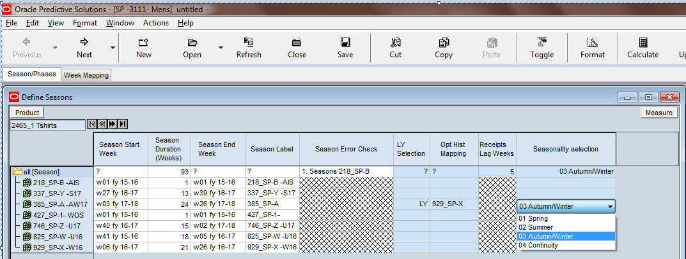
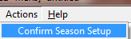
1.1. AP- Setup (Season/week mapping)
@Admin
User needs to select Planning season and map it with last year planning season with Receipt lag weeks
(There should not be any overlap with planning season)
Needs to select seasonality selection drop down based on which season user is planning.
Ex: Planning Season is AW, then Seasonality selection will be 03 Autumn/Winter
If Planning season is Summer, then seasonality selection will be 02 Summer
Then confirm the season set up

Slide 14
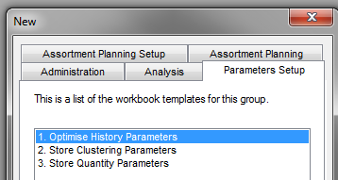
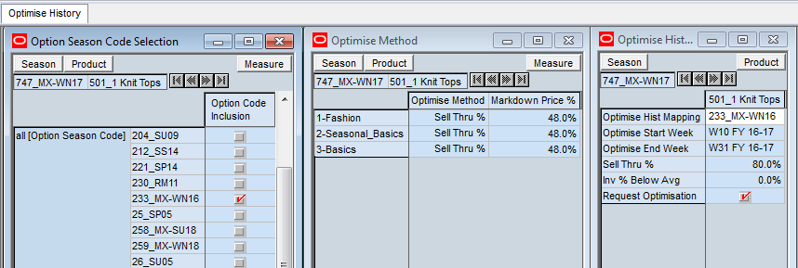
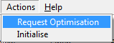
2.1. AP- Parameter Setup (Optimise History Parameters)
1. Option Season code for the history season needs to be selected
2. Optimise Method set as Sell Thru% and Markdown Price % set to 48% by default
3. Click custom menu “Initialize” in order to seed LY Start and End dates
4. Select Classes to optimize history
5. Select “request Optimization” check box and click custom menu “Request Optimization”
This batch will run only in weekends (if user requests for optimization)
For Phase 1: Raw ROS excluding Promo Sales to be considered as ROS for initial Quantity calculation.

Slide 15
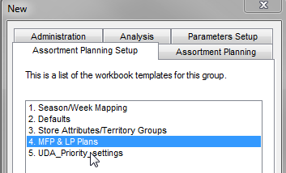
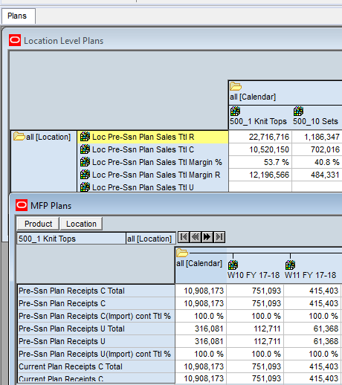
1.5. AP- Setup (MFP & LP Plans review)
@Admin
- Before start of the AP process, users must approve Pre-Ssn Plan Receipts and Pre-Ssn Plan Sales in MFP/LP
- Without correct MFP/LP (Rop) values, AP Planning cannot be done
It will flow to AP by nightly batch
It is read only measure in AP
Pre- Ssn Plan measures consists with Season + Continuity

Slide 16
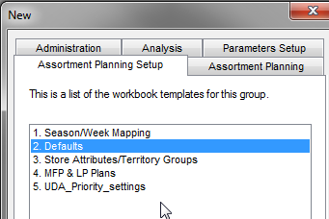
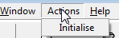
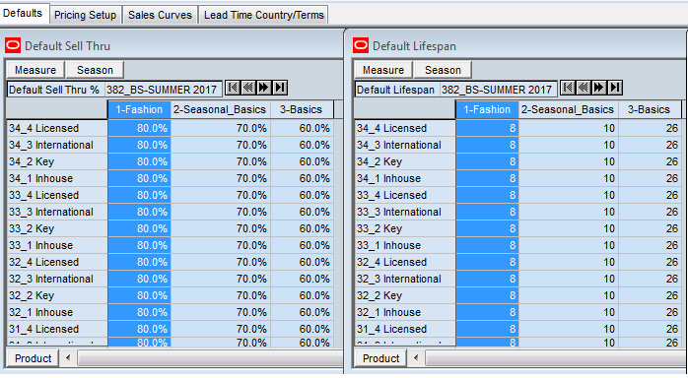
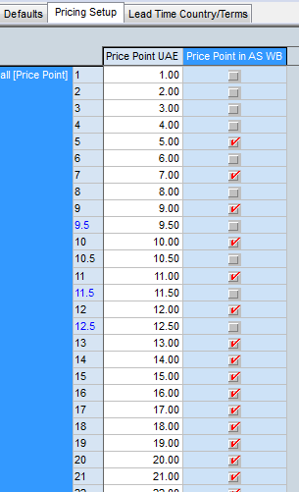
1.2. AP- Setup (Defaults)
@Admin
This workbook contain settings, which are used to prepopulate data further in process. This accelerates the planning process.
Actions:
Click Custom menu Actions—> initialize. This action prepopulates LY PricePoint settings, which are used for Price Points Visibility in AS WB.
Admin enters Default Sell Thru % and Lifespan (weeks) for each APLs(Class) for further calculation of Ideal Depth U in Options/Quantity calculation workbook.

Slide 17
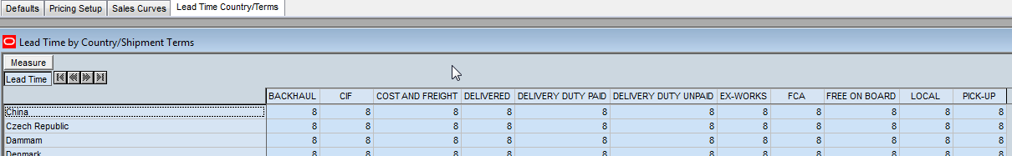
1.2. AP- Setup (Lead Time Country/Terms)
@Admin
Lead time by Country/Shipment terms is filled by Logistics team for order purposes
Helps to derive EDA for the orders

Slide 18
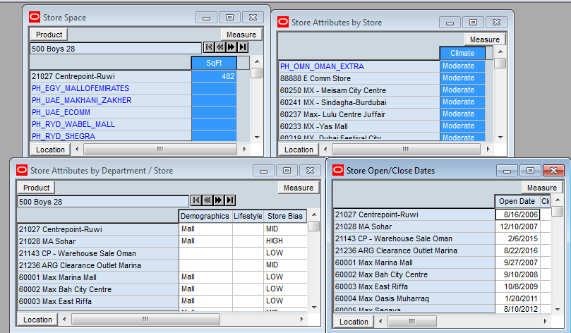
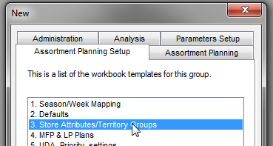
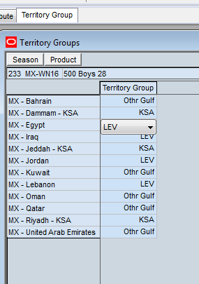
1.3. AP- Setup (Store Attributes/Territory Groups)
@Admin
Store Attributes will flow from LP (if its defined) and its read only measure in AP
Terr. Grp creation helps users to group similar territories for better assortment planning.
It can be used as one of the store clustering attributes . If concepts uses territory Groups for Clustering process, the Admin assign each territory to a group accordingly.

Slide 19
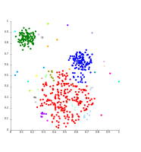
AP – Clustering Set Up
Complete your Clustering Setup….

Slide 20
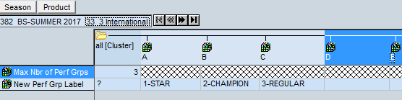
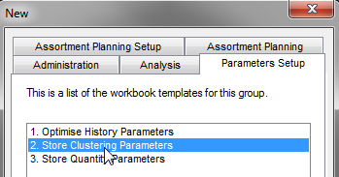
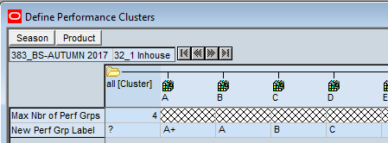
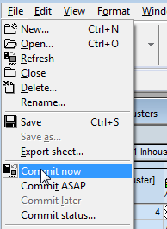
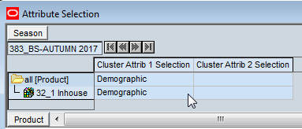
2.2. AP- Parameter Setup (Store Clustering Parameters )
@Admin
Actions:
1. User needs to define “Max Nbr of Perf Grps” (max value - 20)
2. User defines required “New Perf Grp Label” as per no of performance groups
3. Select any attributes to be added to clusters if required (up to two)
3. Click Menu File -> Commit now in order to save settings.

Slide 21


AP – Strategy
Complete your Assortment Strategy !!!

Slide 22
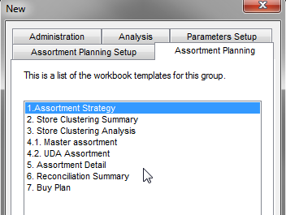
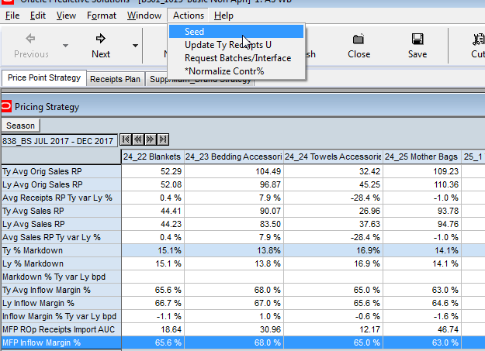
3.1. AP- Assortment Strategy(Price Point Strategy)
@Planners
Actions:
Click custom menu “Seed” in order to populate:
TY data with LY data
MFP Inflow Margin % to TY Inflow Margin %.
LY Sales (RMS) data needs to available for the season to load in AP
Currency Conversion and Conversion factor flow from MFP
Input from MFP:
OTB to be imported on total (Season + continuity ) level.
AUC is on Season + Continuity level.
AP:
Price Points and Margin% are on Season + Continuity level.
AS Receipts U calculated on Season + Continuity level (Territory level considered).

Slide 23
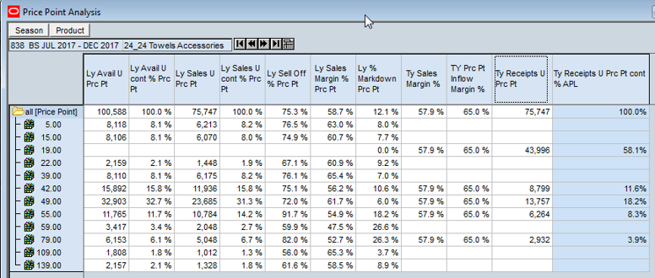
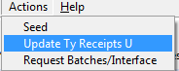
3.1. AP- Assortment Strategy(Price Point Strategy)
@Planners
Price Point Analysis (Units calculation)
Pricing Strategy
Click filtering button (position query) for filtering the prices with historical sales.
Actions:
2. Planners fill in Price Points Contribution % by Class.
The Prices with Contribution% more then zero to be considered further in Units calculation.
System copies Ty Receipts U Prc Pt from AS Receipts Import U on Total Price Points level.
Recommendations: User needs to plan only the meaningful Price points

Slide 24
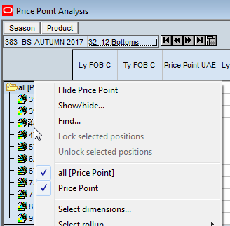
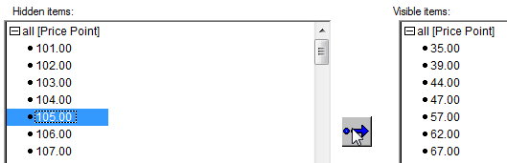
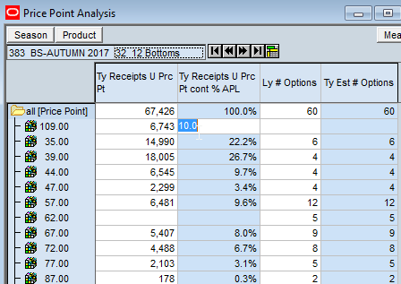
3.1. AP- Assortment Strategy(Price Point Strategy)
@Planners
Recommendations: User needs to plan only the meaningful Price points
3. If required to plan more price points, right click ->
-> Show/hide. Select the Price Point in the left window, click the arrow to add the Price Point selected into the list of visible Price Points.
4. Fill in Contr% for new Price Points.

Slide 25
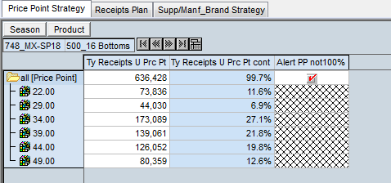
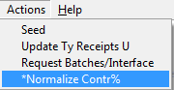
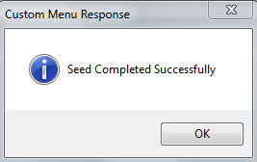
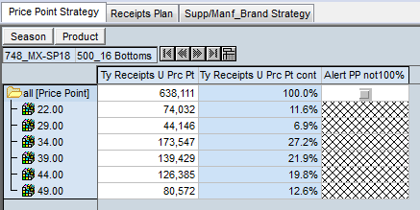
3.1. AP- Assortment Strategy(Price Point Strategy)
@Planners
If Ty Receipts U Prc Pt Cont% at all price point level is not equals to 100% then Alert PP not 100% measure will be check marked.
Click Actions→ *Normalize Contr%*
System will normalize the contr% and at all price point level the contr% will be 100%

Slide 26
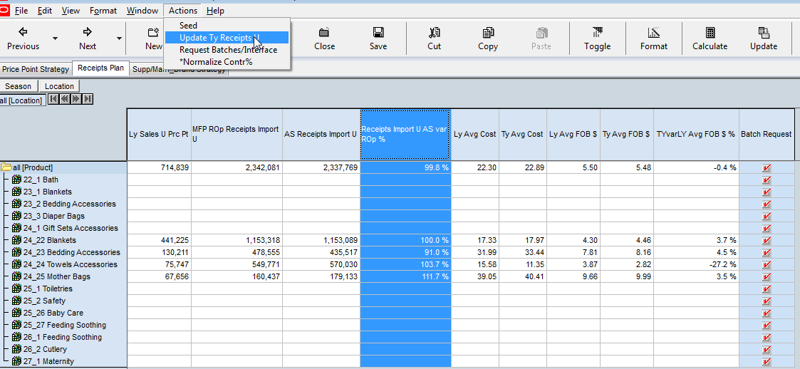
3.1. AP- Assortment Strategy(Receipts Plan in Units)
@Planners
AS Receipts Units calculated on Season + Continuity level.
5. Planners review strategy Units (AS Receipts Import U) and Variance between TY and LY AVG FOB $. If not satisfied needs to change values in Price Point Analysis (Contr % and Margin %)
6. Planners review Margin % on Class level.
7. Once done, check Batch Request check box at Planning Levels required and need to click Request Batches/Interface from custom menu. Batches will spread the AS Import U to store level.

Slide 27
AGENDA
Agenda Day-2
Day-1 Recap 10 mins
Store Clustering Summary 1 hr
Break 10 mins
Store Qty Parameters 15 mins
Option Qty Calculation 2 hrs

Slide 28
Ground Rules
Rules for the Session?
Make the session interactive
Ensure all issues are clearly communicated and captured.
If we don’t know the answer to something, we will log an action on the Action Log and move on
In interest of time, any topic requiring a detailed discussion will be discussed separately.
Please do not use phones during the workshop
Please close your laptops (will use only during hands on)

Slide 29

RECAP

Slide 30

AP – Clustering
Have you reviewed and approved your cluster ??

Slide 31
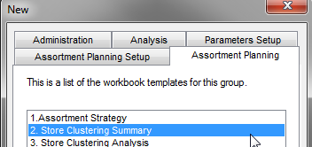
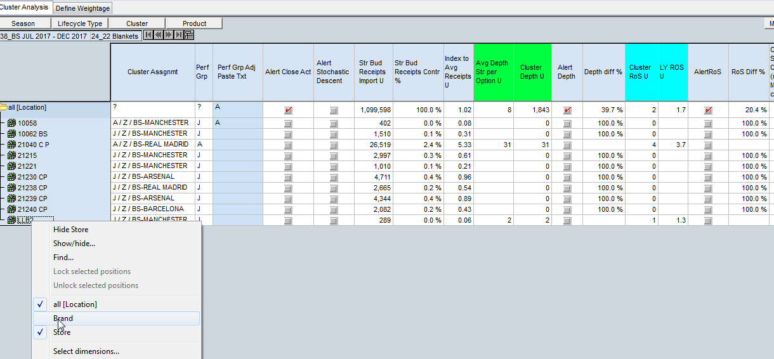
3.2. AP- Store Clustering Summery(Cluster Approval)
@Planners
System assigns each store to certain Performance cluster based on Stochastic descent approach and input KPIs are Pre-Ssn Sales U and ROS with weightage of 75% and 25% accordingly.
Actions:
User can re-assign the clusters if required
and then approve the clusters: select “Approve checkbox” -> click custom menu “Approve clusters”

Slide 32
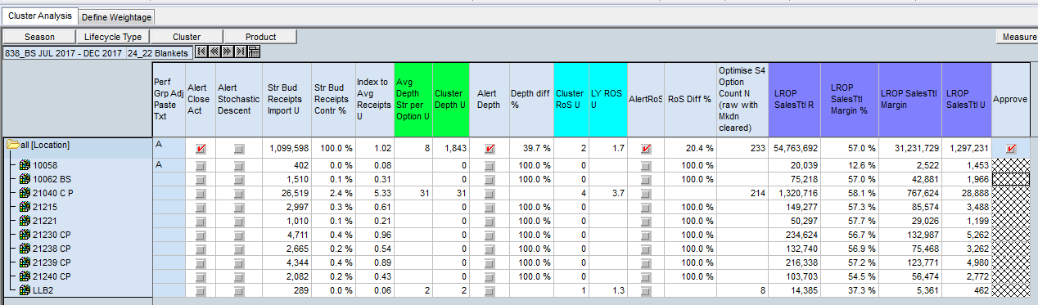
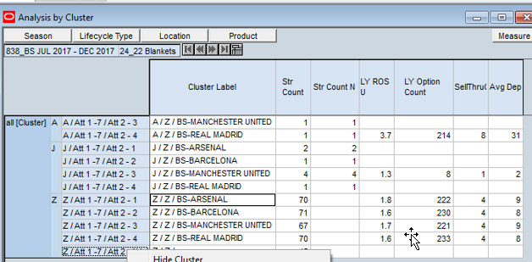
3.2. AP- Store Clustering Summery(Cluster Approval)
@Planners
Review KPI per Store. Alert for ROS and Depth indicates the difference of ROS/Depth for the particular store is more then 30% with the cluster.

Slide 33
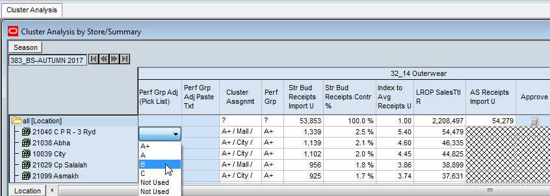
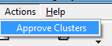
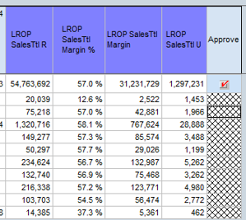
3.2. AP- Store Clustering Summery(Cluster Approval)
User can re-assign performance group before approval. The final cluster assignment will be changed accordingly.
Select Approve check box at all location level and Click Actions → Approve Clusters

Slide 34
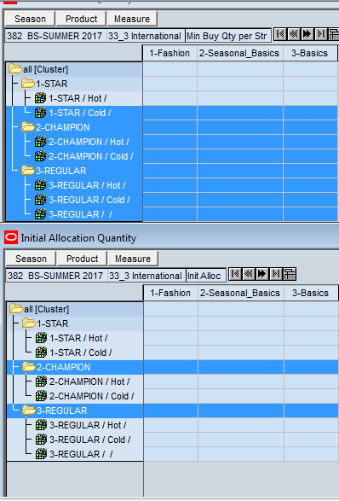
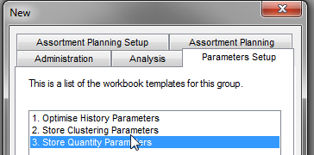
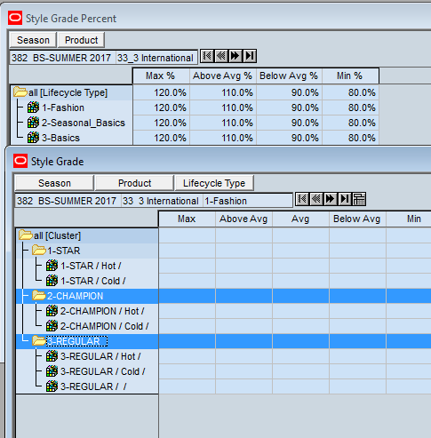
2.3.AP- Parameter Setup (Store Quantity Parameters )
@Admin
Note: WB can be used after clusters are approved.
Actions:
1. User needs to define Min Buy Qty and Initial Allocation Qty
2. In order to set Product Grade:
2.1 click Initialize. The AVG grade is seeded with Depth from “Options/Quantity calculation” workbook.
2.2. Fill in Style Grade %, click custom menu “Recalculate” and system will recalculate Grade based on % filled in.

Slide 35

AP – Option Qty
Have we completed our Option Qty Plan?

Slide 36
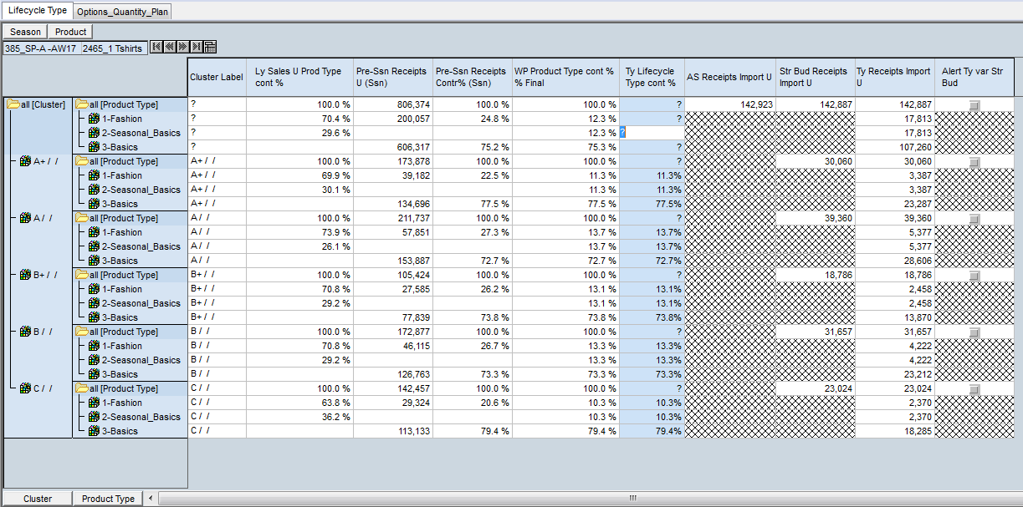
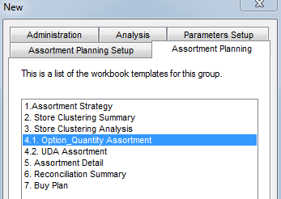
3.3. AP- Option _ Quantity _ Assortment(#Options/Depth)
@Planners
Filtering button to hide unused clusters.
Basic Vs other life cycle type split will be based on Pre-Ssn Receipt U split
Contribution% of Basics will be fixed at the same level as MFP Contribution % always, by system. User can change contr% at All Cluster level for only Fashion and Seasonal Basics. AS Receipt U will be divided by contr% of Lifecycle type.
1. Click from custom menu “Actions” → “0.Initialise”, to initialize/load the data
2. Click Actions→ Normalize Prod life cycle contr% to avoid split error Alert (Store Bud Recpt. U Vs Ty Recpt. Import U)

Slide 37
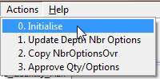
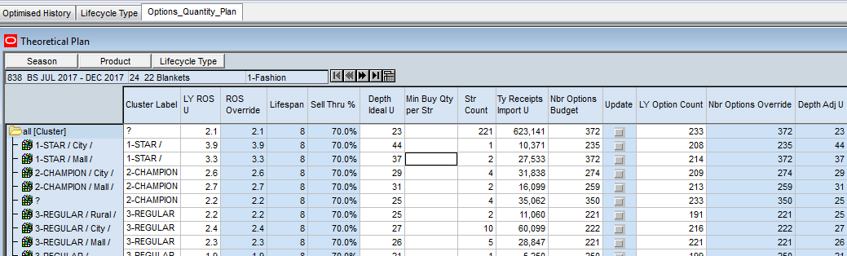
3.3. AP- Option _ Quantity _ Assortment(#Options/Depth)
①
Options _ Quantity _ Plan (Theoretical Plan)
②
③
③
Click “Initialise” from Action menu (ROS, Lifespan, Sell Thru% will be populated)(if its not initialized)
User can override ROS, Lifespan and Sell Thru% for future season
Validate Depth Ideal U and Nbr Options Budget
Depth Ideal U= (ROS Override*Lifespan)/Sell Thru%
Nbr Options Budget = TY Receipts U/ Str Count / Depth Ideal U

Slide 38
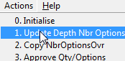
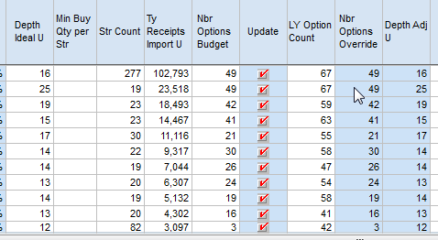
3.3. AP- Option _ Quantity _ Assortment(#Options/Depth)
Options _ Quantity _ Plan (Theoretical Plan)
④
④
4. Select Update check box and click “Update Depth Nbr Options” from Actions menu.
User needs to Click Update Depth Nbr Options (or can directly enter data in Nbr Options Override and in Depth Adj U)
Update Action will copy Depth Ideal U to Depth Adj U and Nbr Options Budget to Nbr Options Override

Slide 39

3.3. AP- Option _ Quantity _ Assortment(#Options/Depth)
Options _ Quantity _ Plan (Theoretical Plan)
⑤
⑥
5. Adjust Number of Options and Depth Adj per Cluster is required.
6. Validate: WP Receipts U, Variance with Units from Strategy, number Avg Buy Quantity.
WP Receipts Import U= Nbr.Opt.Override* Depth Adj U * Str Count
If Depth Adj U < Min Buy Qty then Alert Depth check box will be marked (those options will not be considered )
Avg Buy Qty = WP Receipt Import U / Nbr Options Override

Slide 40


3.3. AP- Option _ Quantity _ Assortment(#Options/Depth)
Options _ Quantity _ Plan (Number Of Options by Phase)
⑦
NbrOptions_Phase_Ovr field gives user flexibility to generate Master Assortment even before user finalized ‘Receipt Import U’
Copy NbrOptionsOvr Action will copy Nbr New Options field values to NbrOptions_Phase_Ovr fields.

Slide 41


3.3. AP- Option _ Quantity _ Assortment(#Options/Depth)
Options _ Quantity _ Plan (Number Of Options by Phase)
For Lifecycle type 3-Basics, 100 % options will be created for Phase I (push) .
For lifecycle type 1-Fashion, options will be created by phase as per MFP Receipts C contribution % (with lags)

Slide 42



3.3. AP- Option _ Quantity _ Assortment(#Options/Depth)
Options _ Quantity _ Plan (Number Of Options by Phase)
⑧
⑧
Action Approve Qty/Options will copy values in Master Assortment Nbr Opt Request fields and update Appr Avg Buy Qty U

Slide 43

3.3. AP- Option _ Quantity _ Assortment(#Options/Depth)
Options _ Quantity _ Plan (Theoretical Plan)

Slide 44
AGENDA
Agenda Day-3
Day-2 Recap 30 mins
UDA Settings 1 hr
Store Qty Parameters 15 mins
Break 10 mins
Master Assortment Creation 2 hrs
** Batches run(1st Interface – 1.5 hrs)

Slide 45
Ground Rules
Rules for the Session?
Make the session interactive
Ensure all issues are clearly communicated and captured.
If we don’t know the answer to something, we will log an action on the Action Log and move on
In interest of time, any topic requiring a detailed discussion will be discussed separately.
Please do not use phones during the workshop
Please close your laptops (will use only during hands on)

Slide 46
RECAP

Slide 47


AP – UDA Priority Settings
Done with your UDA Priority Setup ?

Slide 48




1.5. AP- Setup (UDA _ Priority _ Settings)
- User can select up to 4 UDAs as Attr1/Attr2/Attr3/Attr4 as per UDA _ priority
- Priority and Visibility should be in align (for selected UDAs, Set_UDA_visibility should be checked)
- Priority is used for UDA Decision tree in order to plan and assign UDA Contribution % in Master Assortment.

Slide 49



1.5. AP- Setup (UDA _ Priority _ Settings)
@Admin
Sorting of UDA values
To order price points:
1. Right click on Price points hierarchy and select display and sort attributes
2. Take Price Point Sorting to right side Sort attributes.
3. Drag Price Point Sorting above Label and Click OK as per screen

Slide 50
2.3.AP- Parameter Setup (Store Quantity Parameters )
@Admin
Note: WB can be used after clusters are approved.
Actions:
1. User needs to define Min Buy Qty and Initial Allocation Qty
2. In order to set Product Grade:
2.1 click Initialize. The AVG grade is seeded with Depth from “Options/Quantity calculation” workbook.
2.2. Fill in Style Grade %, click custom menu “Recalculate” and system will recalculate Grade based on % filled in.

Slide 51


AP – Master Assortment
Complete your Master Assortment

Slide 52


AP- Master_ Assortment
@Planners
UDA _ Priority
It will display UDA priority list as per defined in UDA _ Priority _ Settings WB (Read Only field).User can change UDA values in UDA_Priority_Settings WB.

Slide 53



AP- Master Assortment
Attribute _ 1 (UDA % Calculation)
Click position query button to filter attributes.
Or set Automatic filtering in the workbook:
Actions:
User Needs to fill Contribution % of Attribute _1 (UDA 1)(Horizontally 100%)
Alert UDA1 not 100% will be checked if contribution% is not equal to 100%
Data can be filled at highest (all clusters) level.

Slide 54

AP- Master Assortment
Attribute _ 1 (UDA % Calculation)
UDA1% Over Clst Lvl – Measure for planning UDA Contr% on Cluster Level (lowest level) . The measure could be used to be filled in on highest level to spread the value to lowest. Aggregation is Average.
UDA1% All Clusters Final – the measure has the same value on lowers level as previous measure, but has different aggregation Hybrid, which is logical: SUM for aggregation from UDA value to UDA name, AVERAGE for aggregation from cluster to All Clusters.
The same logic is implemented for all 4 UDA and planning measures related.

Slide 55

AP- Master Assortment
Attribute _ 1 (UDA % Calculation)
Note: Optional aggregation of clusters is available upon right click mouse button.

Slide 56


AP- Master Assortment
Attribute _ 2 (UDA % Calculation)
User needs to fill contribution% vertically for each UDA_2 values against UDA_1
Note: Outline view and Attribute Name and Value will provide user friendly view. Alert UDA not100% will be checked if contribution% is not equal to 100%

Slide 57


AP- Master Assortment
Attribute _ 2 (UDA % Calculation)
Right click to show lower levels of Clusters hierarchy.

Slide 58

AP- Master Assortment
Custom menu to clean the UDA Contr% 1,2,3 if required.

Slide 59



AP- Master Assortment(options-quantity)
User needs to click Actions→0.Copy _NbrOptionsApproved
It will copy:
#Options requested and calculated in previous WB, Options/Qty calculation.
Avg Buy Quantity – it is not amendable and calculated in the previous step and WB “Options/Quantity calculation”
User can update Nbr of options field (not reconciled on total level with budget in Phase 1)

Slide 60


AP- Master Assortment(options-quantity)
User needs to click Actions→1. Create _ Master _ Assortment

Slide 61



AP- Master Assortment
PreView master Assortment
Filtering button or Automatic calculation.
* Right vclick om Measure -> From Show/Hide option include “Internal Sort N”
Roll it up to all lines in Outline view and Click Descending by selection of Internal Sort N

Slide 62

AP- Master Assortment
PreView master Assortment
User are able to view the Wedge pattern based PHs assignment with clusters

Slide 63


AP- Master_ Assortment
Options/Qty calculation Vs PreView master Assortment
#Options/Qty calculation WB
UDA and Master assortment
User can validate Total Qty/ Avg Buy Qty per cluster level from the two WBs
Total no of options also can be validated per cluster wise if there is no override from users
#Master Assortment WB

Slide 64

AP- Master_ Assortment
Options/Qty calculation Vs PreView master Assortment
User can assign 4 additional UDA

Slide 65

AP- Master Assortment
Approve Master Assortment
User needs to check Approve Check Box and then click
Actions → 2. Approve _ MasterAssortment
Approval of Master Assortment by Class

Slide 66

AP- Master Assortment
Review Master Assortment approved

Slide 67
AGENDA
Agenda Day-4
PLM Matching 1.5 hrs
Batches Run- 2nd Interface + Break 30 mins
Assortment Detail - Plan Options 1 hr
Batches Run 15 mins
File Buying week (SPL & IC) 1 hr
** Batches run – 30 mins

Slide 68
Ground Rules
Rules for the Session?
Make the session interactive
Ensure all issues are clearly communicated and captured.
If we don’t know the answer to something, we will log an action on the Action Log and move on
In interest of time, any topic requiring a detailed discussion will be discussed separately.
Please do not use phones during the workshop
Please close your laptops (will use only during hands on)

Slide 69

PLM
Completes your PLM Process !
(PLM Matching)

Slide 70


AP – Assortment Detail
Is your Final Quantities approved in Assortment Detail?

Slide 71



AP- Assortment Detail (Plan Option)
The Plan Options tab is used to plan the details of each option that was matched in PLM.
1. Load the AD WB
2. By default Initialise check box will be marked (1st time) and click Actions—>Initialise

Slide 72






AP- Assortment Detail (Plan Option)
3. User can change Style/ROS grade and Sales curve and then click Action →style / ROS Grade Qty
4. Action→Update Depth Rev Cluster

Slide 73



AP- Assortment Detail (Territory & Approve) (Except Splash/IC)
4. Click Action →Spread to Store (same for Splash/IC)
5. Click Action →Update Str Rev Receipts(Others)
At option-Territory or option-store level quantity can be modified before the approval of final quantity(Others)

Slide 74








Buy Week Feed For Splash and Iconic :
Export to Buy Week
The Assortment Detail plan will be exported to PLM to create the Buy Week. After reviewing the plans with the Territories, the updated Buy Week will be imported back into Assortment Detail for approval.
On the Territory & Approve tab and the Review by Options by Territory worksheet, verify the Rev Str Receipts Source is set to Wp Str Receipts.
In the Buy Week Export, select Buy Week
1
2
3
At the all[Product] level, click the Update Str Rev Receipts Import U checkbox and click calculate.
Navigate to the Approve Options worksheet on the Territory & Approve tab
In the Action menu, select Update Str Rev Receipts to update the Rev Str Receipts Import U for all options.
4
Review the Alert Depth Rev U
Click the Unapproved measure at all[Product] level to flag all options to be fed to PLM
5
6
In the Actions menu, select Unapprove

Slide 75
PLM
Completes your PLM Process !
(File Buying Week)

Slide 76
AGENDA
Agenda Day-5
Assortment Detail contd.. 1 hr
Batches (3rd Interface) + Break 1.5 hrs
PLM PreOrder Readiness: Style confirmation 1.5 hrs
Reconciliation Summary (Receipts only) 15 mins

Slide 77
Ground Rules
Rules for the Session?
Make the session interactive
Ensure all issues are clearly communicated and captured.
If we don’t know the answer to something, we will log an action on the Action Log and move on
In interest of time, any topic requiring a detailed discussion will be discussed separately.
Please do not use phones during the workshop
Please close your laptops (will use only during hands on)

Slide 78
AP – Assortment Detail
Is your Final Quantities approved in Assortment Detail?

Slide 79





Buy Week Feed For Splash and Iconic :
Import from Buy Week and Final Quantity
Once the Buy Week is updated it will be fed back to Assortment Detail. Follow the steps below to import the Buy Week and approve the options
In the Actions menu, select Update Rev Receipts.
On the Territory & Approve tab and the Review by Options by Territory worksheet, in the Rev Str Receipts Source select Buy Week Feed.
1
2
In the Buy Week Export, select Final Qty
3
Click the Approved measure at all[Product] level to flag all options to be fed to PLM
4
Review the Alert Depth Rev U
5
In the Actions menu, select Approve

Slide 80



AP- Assortment Detail (Territory & Approve) (Except Splash/IC)
6. Click Action →Approve (Planner’s Approval)
Any Option can be Unapproved till the time Buyer Approved in Buy Plan.

Slide 81
PLM
Completes your PLM Process !
(Pre-order Readiness)

Slide 82

Reconciliation
View Planned vs Actual !

Slide 83


AP- Reconciliation Summary
Receipts Reconciliation

